Slide 1
Performance Metrics for Machine Translation model
NLP COE Internal updates
3/22/2022
Meet Paradia

Slide 2
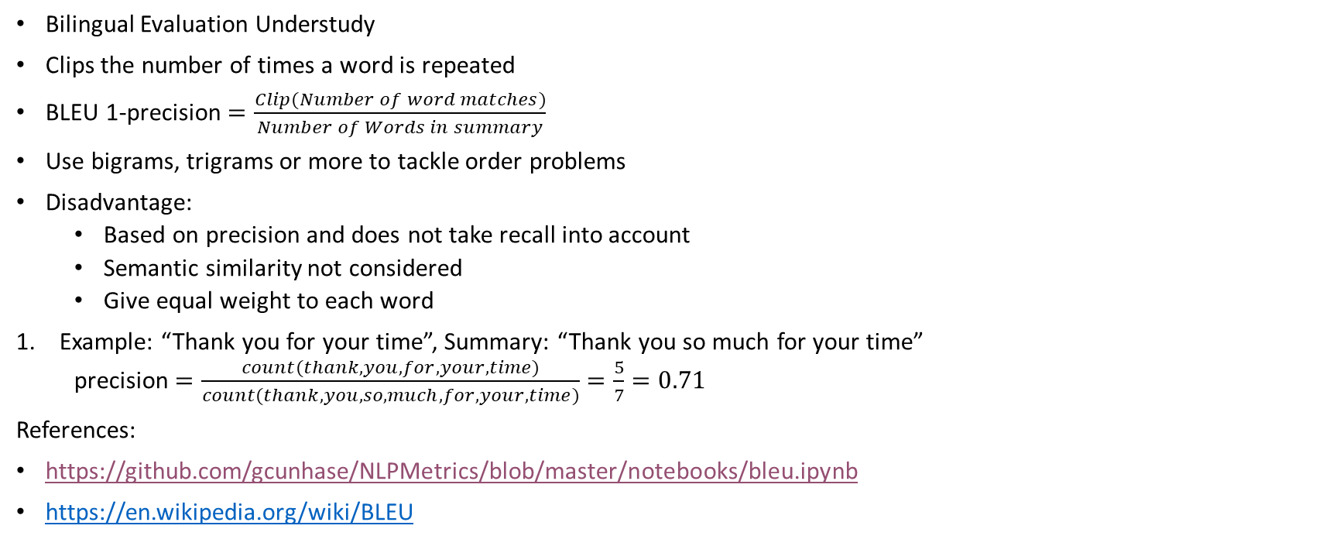
BLEU Metric
Bilingual Evaluation Understudy
Clips the number of times a word is repeated
BLEU 1-precision $=\frac{Clip(Number of word matches)}{Number of Words in summary}$
Use bigrams, trigrams or more to tackle order problems
Disadvantage:
Based on precision and does not take recall into account
Semantic similarity not considered
Give equal weight to each word
Example: “Thank you for your time”, Summary: “Thank you so much for your time”
precision $=\frac{count(thank, you,for, your, time)}{count(thank, you, so, much, for, your, time)}=\frac{5}{7}=0.71$
References:
https://github.com/gcunhase/NLPMetrics/blob/master/notebooks/bleu.ipynb
https://en.wikipedia.org/wiki/BLEU

Slide 3
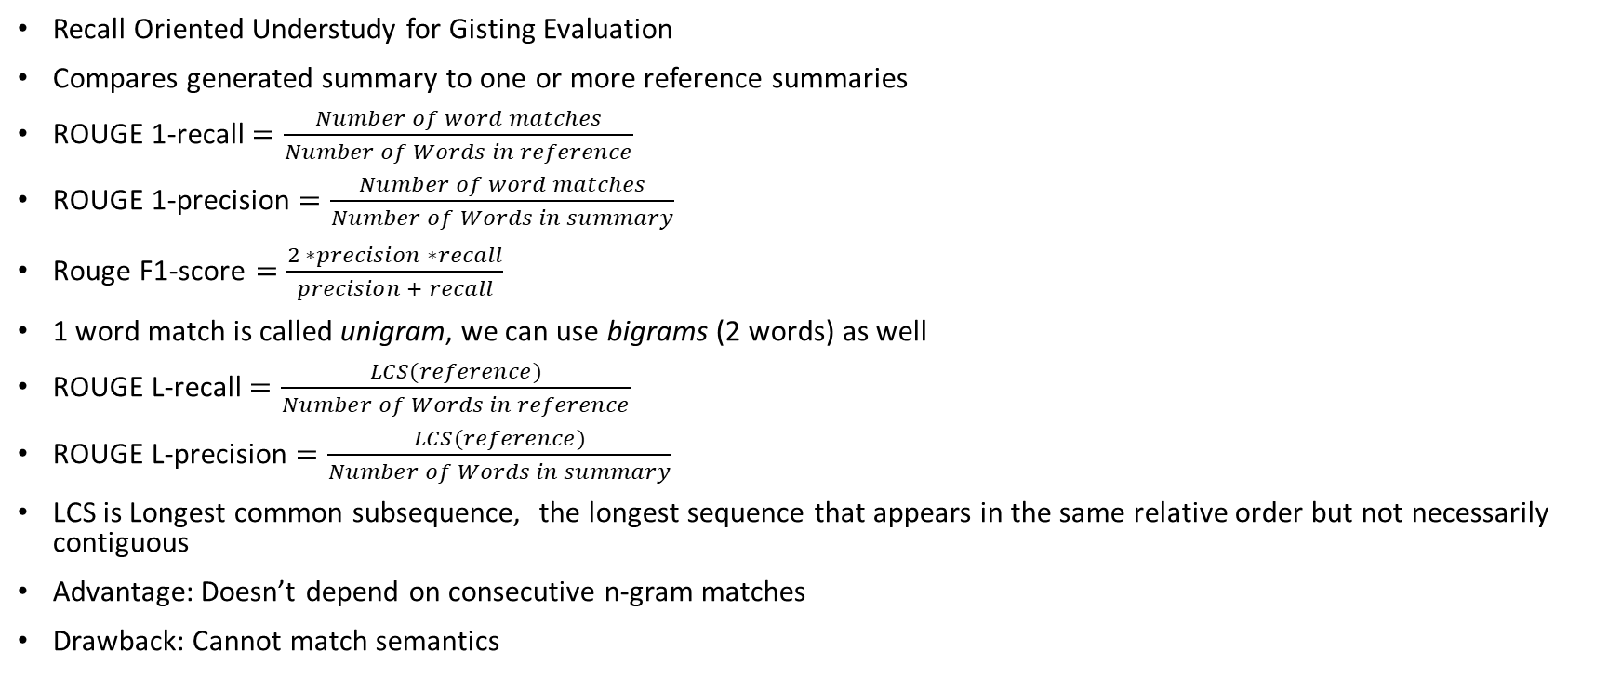
ROUGE Metric
Recall Oriented Understudy for Gisting Evaluation
Compares generated summary to one or more reference summaries
ROUGE 1-recall $=\frac{Number of word matches}{Number of Words in reference}$
ROUGE 1-precision $=\frac{Number of word matches}{Number of Words in summary}$
$\text{Rouge} \text{F}\text{1−}\text{score}=\frac{2 ∗precision ∗recall}{precision + recall}$
1 word match is called unigram, we can use bigrams (2 words) as well
ROUGE L-recall $=\frac{LCS(reference)}{Number of Words in reference}$
ROUGE L-precision $=\frac{LCS(reference)}{Number of Words in summary}$
LCS is Longest common subsequence, the longest sequence that appears in the same relative order but not necessarily contiguous
Advantage: Doesn’t depend on consecutive n-gram matches
Drawback: Cannot match semantics

Slide 4
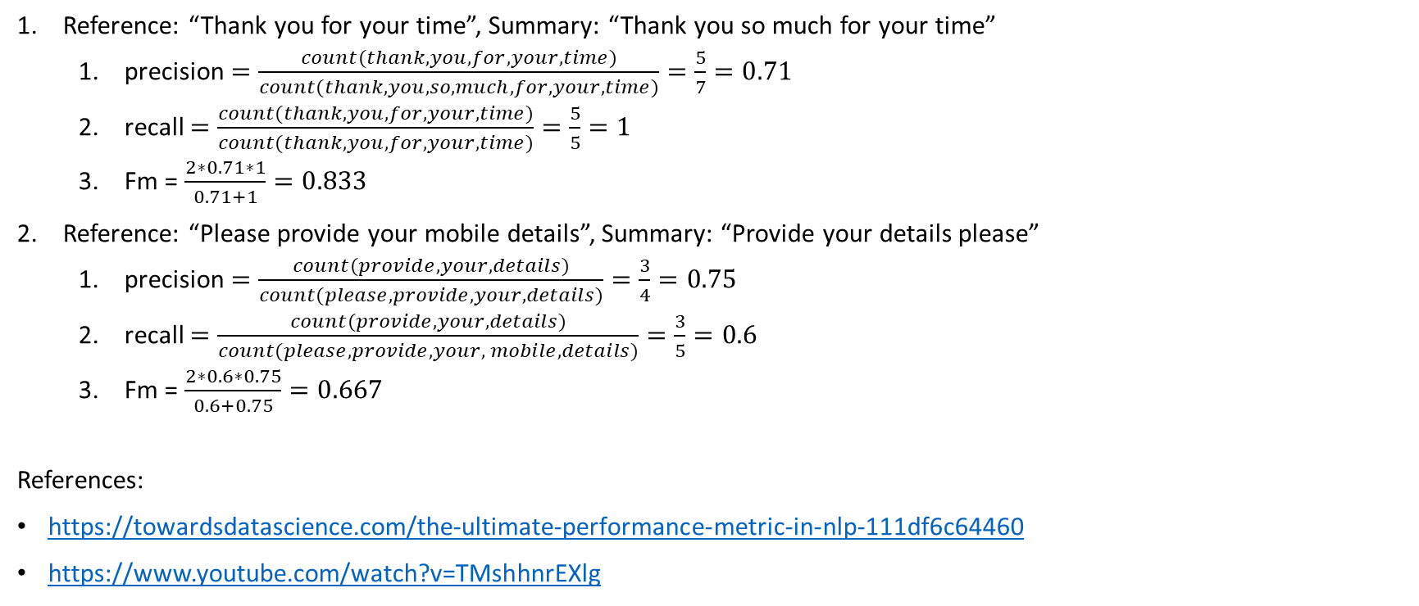
Examples
Reference: “Thank you for your time”, Summary: “Thank you so much for your time”
precision $=\frac{count(thank, you,for, your, time)}{count(thank, you, so, much, for, your, time)}=\frac{5}{7}=0.71$
recall $=\frac{count(thank, you,for, your, time)}{count(thank, you, for, your, time)}=\frac{5}{5}=1$
Fm = $\frac{2∗0.71∗1}{0.71+1}=0.833$
Reference: “Please provide your mobile details”, Summary: “Provide your details please”
precision $=\frac{count(provide, your, details)}{count(please, provide, your, details)}=\frac{3}{4}=0.75$
recall $=\frac{count(provide, your, details)}{count(please, provide, your, mobile, details)}=\frac{3}{5}=0.6$
Fm = $\frac{2∗0.6∗0.75}{0.6+0.75}=0.667$
References:
https://towardsdatascience.com/the-ultimate-performance-metric-in-nlp-111df6c64460
https://www.youtube.com/watch?v=TMshhnrEXlg

Slide 5
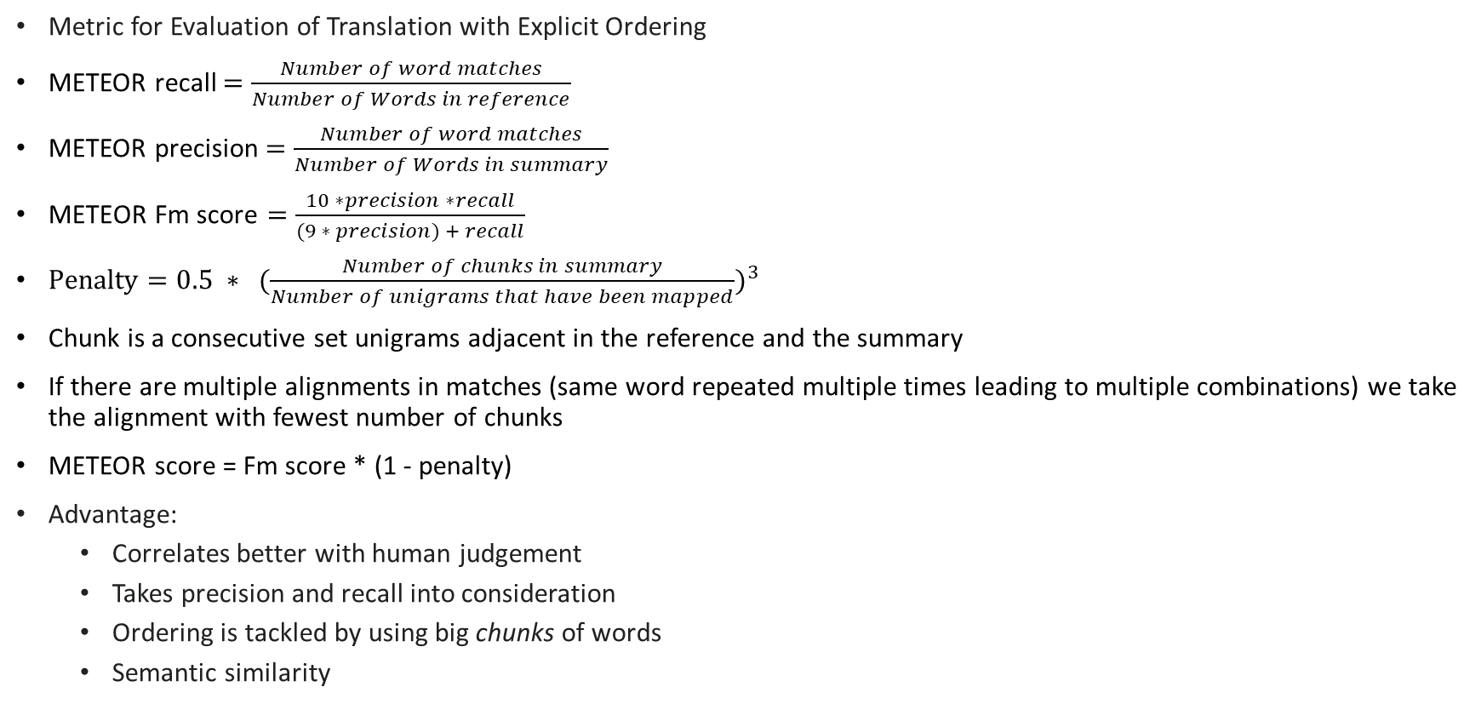
METEOR Metric
Metric for Evaluation of Translation with Explicit Ordering
METEOR recall $=\frac{Number of word matches}{Number of Words in reference}$
METEOR precision $=\frac{Number of word matches}{Number of Words in summary}$
$\text{METEOR} \text{Fm} \text{score}=\frac{10 ∗precision ∗recall}{(9 ∗ precision) + recall}$
$Penalty=0.5 ∗ ({\frac{Number of chunks in summary}{Number of unigrams that have been mapped})}^{3}$
Chunk is a consecutive set unigrams adjacent in the reference and the summary
If there are multiple alignments in matches (same word repeated multiple times leading to multiple combinations) we take the alignment with fewest number of chunks
METEOR score = Fm score * (1 - penalty)
Advantage:
Correlates better with human judgement
Takes precision and recall into consideration
Ordering is tackled by using big chunks of words
Semantic similarity

Slide 6
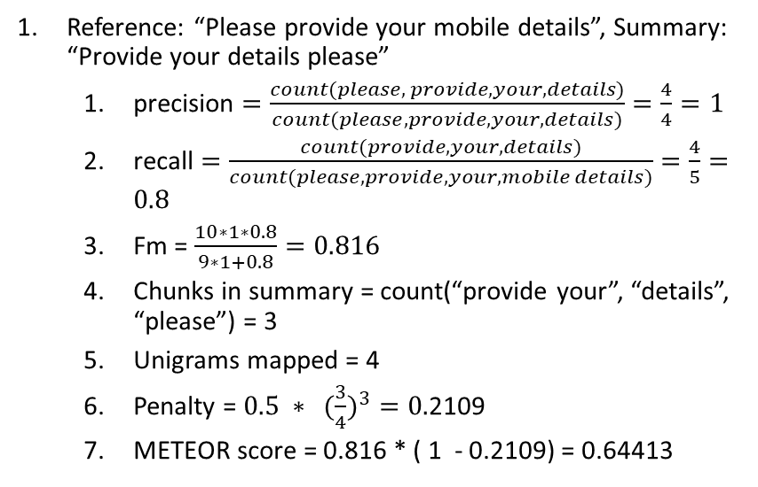
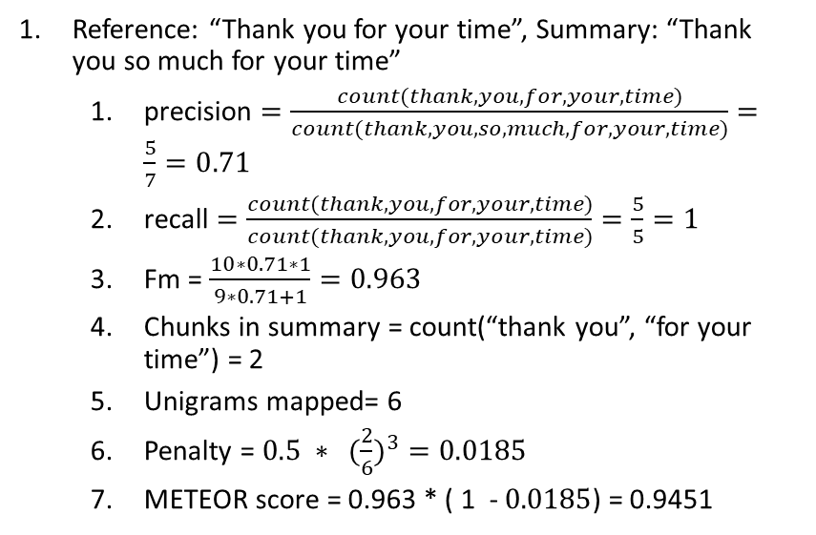
Examples
Reference: “Thank you for your time”, Summary: “Thank you so much for your time”
precision $=\frac{count(thank, you,for, your, time)}{count(thank, you, so, much, for, your, time)}=\frac{5}{7}=0.71$
recall $=\frac{count(thank, you,for, your, time)}{count(thank, you, for, your, time)}=\frac{5}{5}=1$
Fm = $\frac{10∗0.71∗1}{9∗0.71+1}=0.963$
Chunks in summary = count(“thank you”, “for your time”) = 2
Unigrams mapped= 6
Penalty = $0.5 ∗ ({\frac{2}{6})}^{3}=0.0185$
METEOR score = 0.963 * ( 1 - $0.0185$) = 0.9451
Reference: “Please provide your mobile details”, Summary: “Provide your details please”
precision $=\frac{count(please, provide, your, details)}{count(please, provide, your, details)}=\frac{4}{4}=1$
recall $=\frac{count(provide, your, details)}{count(please, provide, your, mobile details)}=\frac{4}{5}=0.8$
Fm = $\frac{10∗1∗0.8}{9∗1+0.8}=0.816$
Chunks in summary = count(“provide your”, “details”, “please”) = 3
Unigrams mapped = 4
Penalty = $0.5 ∗ ({\frac{3}{4})}^{3}=0.$2109
METEOR score = 0.816 * ( 1 - 0.2109) = 0.64413
References:
https://en.wikipedia.org/wiki/METEOR
https://youtu.be/FqQbrlEh_b0

Slide 7
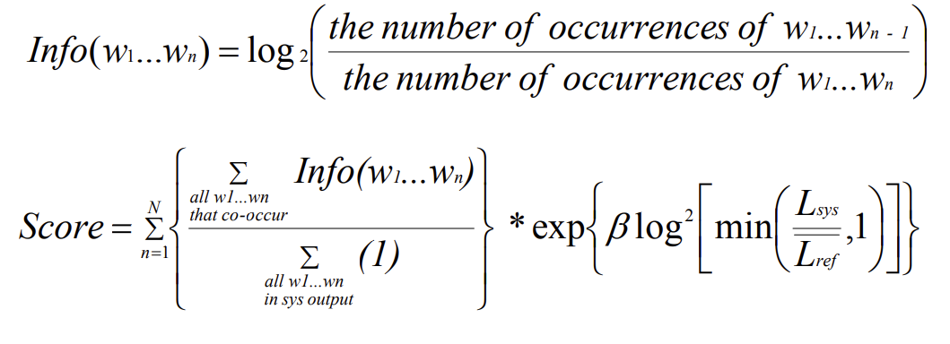
NIST Score
BLEU
Arithmetic mean
More information = more weight
NIST
Improve BLEU by rewarding the translation of infrequently used words
Heavier weights ➔ infrequent words
Arithmetic mean over Geometric mean
Notes:
AM over GM as there exists the potential of counterproductive variance due to low co-occurrences for larger values of N.
Instead of n-gram precision, uses the information gain from each n-gram
More reliable and better quality than bleu

Slide 8
NIST References
https://aclanthology.org/www.mt-archive.info/HLT-2002-Doddington.pdf
https://www2.spsc.tugraz.at/www-archive/AdvancedSignalProcessing/WS06-MachineTranslation/MTEvaluation_Sakir.pdf
https://isl.anthropomatik.kit.edu/pdf/Zhang2004.pdf
https://arxiv.org/ftp/arxiv/papers/1601/1601.02789.pdf

Slide 9
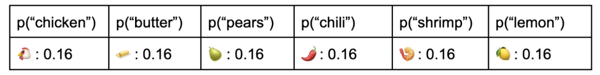
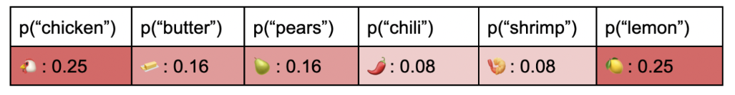
Entropy and Perplexity
Definitions:
Entropy: Amount of information contained in the variable
Perplexity: Amount of randomness in the variable.
Tasty recipes:
Take 1:
Chicken, Butter, Pears
Chicken, Butter, Chili
Lemon, Pears, Shrimp
Chili, Shrimp, Lemon
Take 2:
Chicken, Butter, Pears
Chicken, Butter, Lemon
Chicken, Lemon, Pears
Chili, Shrimp, Lemon

Slide 10

Entropy and Perplexity Calculations
How surprised are you to see a variable appear in the recipe (for example chicken)?
When you are certain that an event will occur (1), your surprise when it happens is null (0); and when you are certain that an event will not occur your surprise when it happens is infinite!
$Surprisal= S\left(x\right)=log\left(\frac{1}{p\left(x\right)}\right)=−log\left(p\left(x\right)\right)$
Entropy is the expected value of surprisal across every possible outcome
Entropy = $H\left(p\right)=−\sum_{i}{p_{i}\log_{2}\left(p_{i}\right)}$
$Perplexity=2^{H(p)}=2^{−\sum_{i}{p_{i}\log_{2}\left(p_{i}\right)}}$
Interpretations: Lower Perplexity ➔ More Certainty ➔ Stronger model
Used case: dialog generation
References:
https://www.surgehq.ai/blog/how-good-is-your-chatbot-an-introduction-to-perplexity-in-nlp
https://towardsdatascience.com/perplexity-in-language-models-87a196019a94
https://towardsdatascience.com/the-relationship-between-perplexity-and-entropy-in-nlp-f81888775ccc

Slide 11
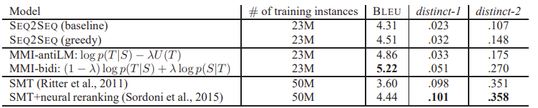

Distinct Score
To capture the textual diversity of the generated text by calculating the number of distinct n-grams
Used case ➔ when we need to diversify the outputs
Good reply ≠ Good model
$score=\frac{total number of unigrams and bigrams generated in the hypothesis}{total number of tokens in the hypothesis}$
References:
https://arxiv.org/pdf/1510.03055.pdf
https://paddlenlp.readthedocs.io/en/latest/source/paddlenlp.metrics.distinct.html
Message | Chatbot Reply
Hello, I missed my flight SW4589 from BWI to DAL, can I get a refund? | Hi, thank you for reaching out to us, we will connect you with an agent
Terrible service, have been waiting for an agent for 4 hours and no one seems to respond | Hi, thank you for reaching out to us, we will connect you with an agent
Loved the Fajitas! The queso was rich and creamy | Hi, thank you for reaching out to us, we will connect you with an agent
Notes:
The value is scaled by total number of generated tokens to avoid favoring long sentences

Slide 12
References
NIST:
Source code: https://www.nltk.org/_modules/nltk/translate/nist_score.html
Theory and formula: https://www2.spsc.tugraz.at/www-archive/AdvancedSignalProcessing/WS06-MachineTranslation/MTEvaluation_Sakir.pdf
Good research papers: https://aclanthology.org/www.mt-archive.info/HLT-2002-Doddington.pdf
Entropy/ Perplexity:
Maths and derivation of formula: https://towardsdatascience.com/perplexity-in-language-models-87a196019a94
Understanding concept of perplexity with example: https://www.surgehq.ai/blog/how-good-is-your-chatbot-an-introduction-to-perplexity-in-nlp
Article explaining relation between perplexity and entropy (formula): https://www.analyticsvidhya.com/blog/2020/11/entropy-a-key-concept-for-all-data-science-beginners/
Code using Perplexity as a metric for chatbot problem: https://medium.com/@oberoiheman/building-a-generative-chat-bot-using-deep-learning-and-nlp-3b6e09d45fe9
Paddlenlp.metrics library: https://paddlenlp.readthedocs.io/en/latest/source/paddlenlp.metrics.perplexity.html
Distinct score:
Source code: https://github.com/neural-dialogue-metrics/Distinct-N/blob/master/distinct_n/metrics.py
Paddlenlp.metrics library: https://paddlenlp.readthedocs.io/en/latest/source/paddlenlp.metrics.distinct.html
Research paper using distinct score for twitter chatbot: https://arxiv.org/pdf/1510.03055.pdf
Other important links:
Research paper for all metrics: https://arxiv.org/ftp/arxiv/papers/1601/1601.02789.pdf
Research paper for used cases of metrics: https://towardsdatascience.com/evaluation-metrics-assessing-the-quality-of-nlg-outputs-39749a115ff3
Commonly used metrics: https://arxiv.org/pdf/2008.12009.pdf

Slide 13
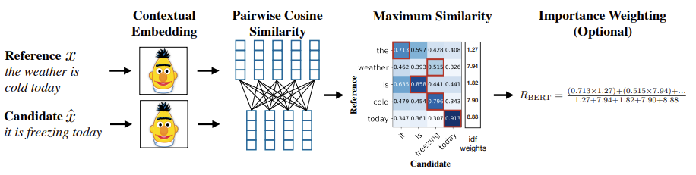
BERT Score
Why BERT?
Does not rely on maximum n-gram ➔ uses contextualized embeddings
Trained on large amount of raw text (in 104 languages!)
Cosine similarity + importance weighting
Step 1: Contextual Embedding:
Same word can generate different vector representations because of surrounding words
MLM + NSP
Step 2: Similarity Measure:
Soft measure of similarity instead of exact string match
Cosine similarity

Slide 14
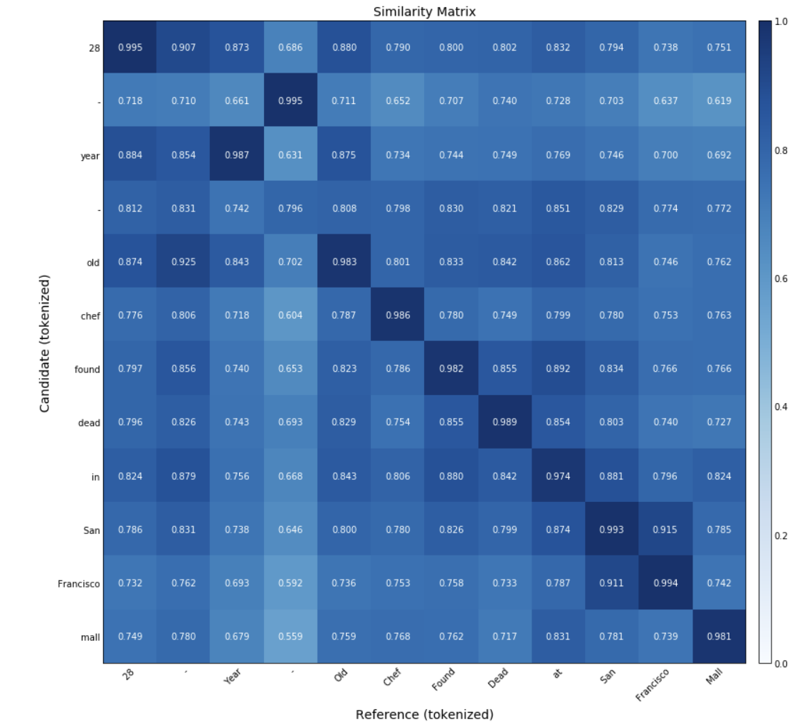
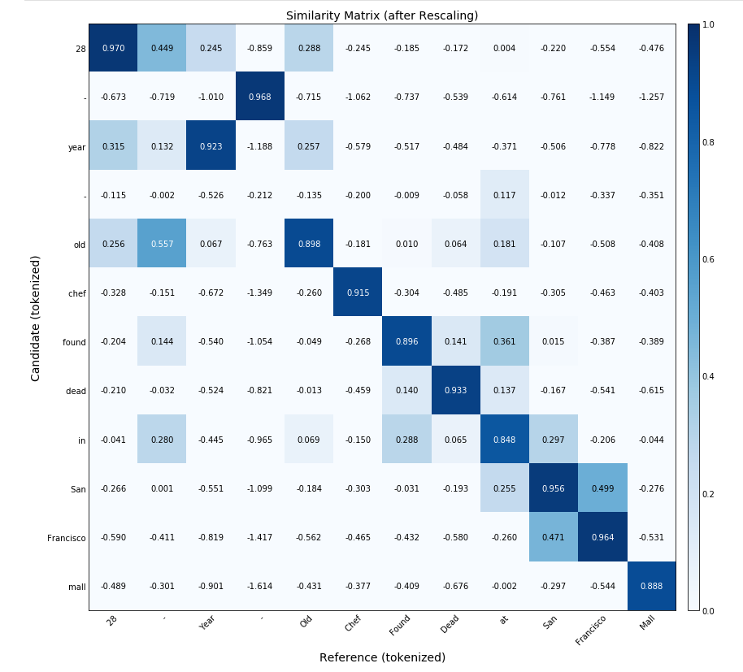

BERT Score
Step 3: BERT Score:
Calculate recall, precision and F1 score
Step 4: Importance Weighting:
Rare words are more significant than common words
$idf\left(t\right)=\log\left(\frac{N}{df+1}\right)$; Where t = word, df = occurrences of word in document, N = count of corpus
Don’t use tf-df ➔ as we process single sentences wherein tf = 1
Step 5: Baseline Rescaling:
References:
https://arxiv.org/pdf/1904.09675.pdf
https://github.com/Tiiiger/bert_score

